Slide 1
Lesson 7: Data Manipulation ---useful functions and packages in R
Chris Qi

Slide 2


Slide 3
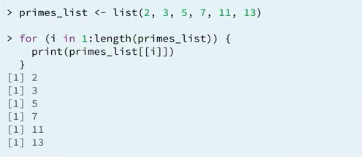
Part1: for loops in R (循环)
For loops are for iterations
Notes:
快速执行命令，对每一个对象执行同样的操作。省时省力，少写代码，简单明了，不易出错，好修改。
Identify elements of a list using the [[]] convention.

Slide 4



parts of a for loop
sequence:
body:
Output:

Slide 5
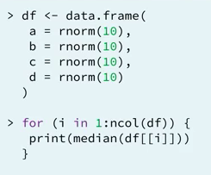
looping over columns in a data frame

Slide 6
Part 2: apply functions
apply
lapply
sapply

Slide 7
apply(object, margin, function, ...)
margin specifies which dim to iterate.
1=row
2=column
c(1,2) both
... additional function options

Slide 8

apply(object, margin, function, ...)

Slide 9
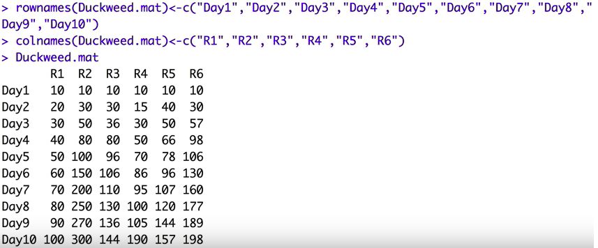

Slide 10

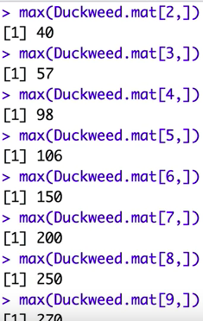
lappy and sapply

Slide 11
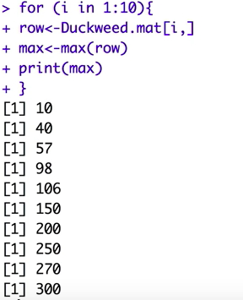

Slide 12



Slide 13
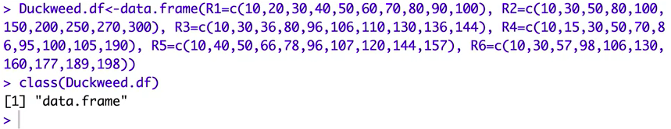

Slide 14
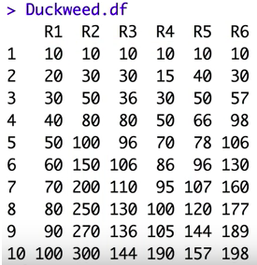

Slide 16

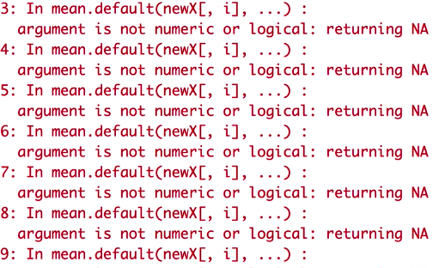

Slide 18
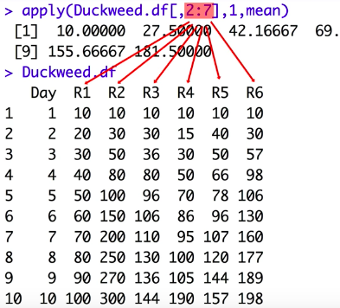

Slide 20
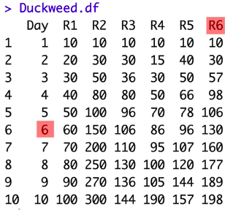
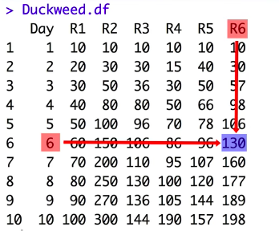

Slide 21
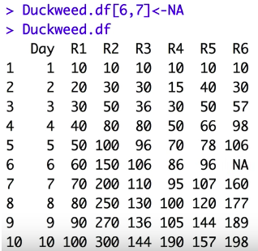

Slide 22
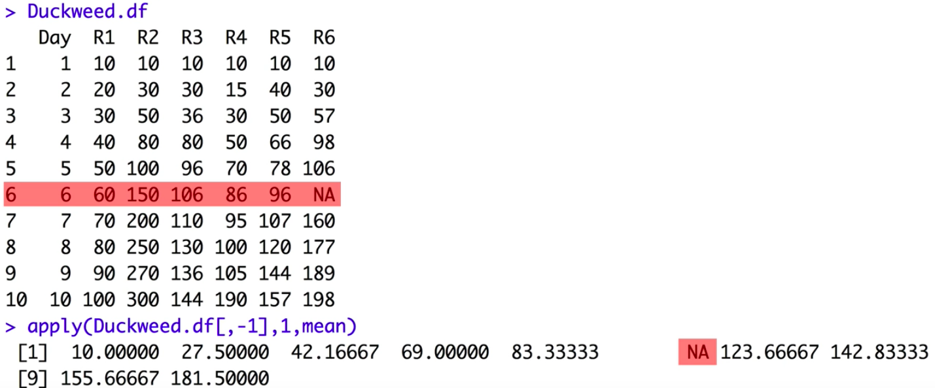

Slide 23
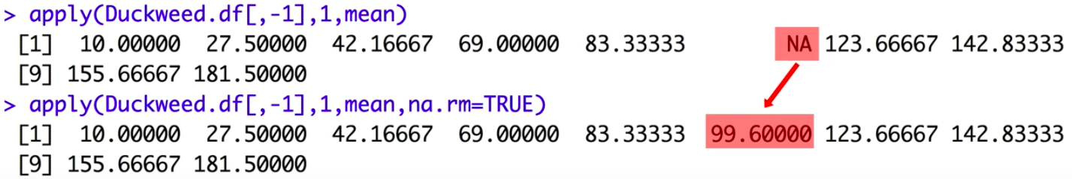
na.rm
apply(object, margin, function, ...)

Slide 24
lapply() and sapply()
lapply(object, function, ...)
object: list, vector, data frame
OUTPUT: only list

Slide 25
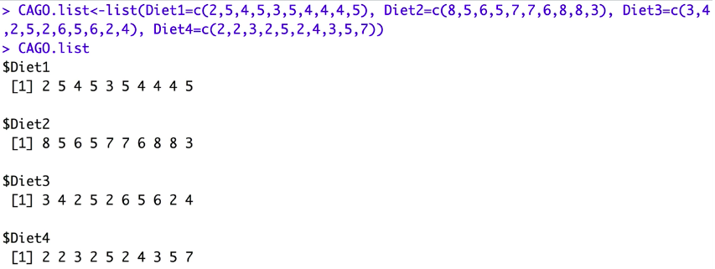

Slide 26
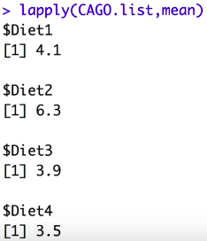

Slide 27
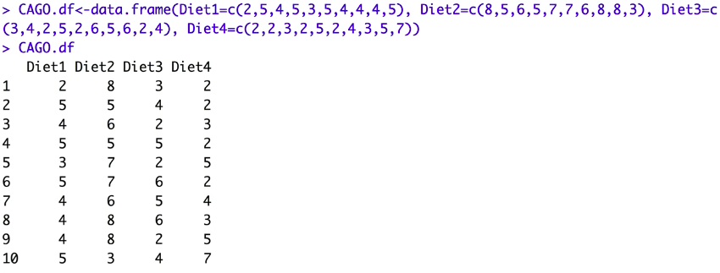

Slide 28
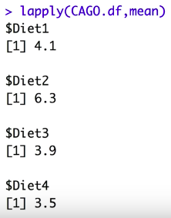
lapply assumes we are working with column

Slide 29


Slide 30
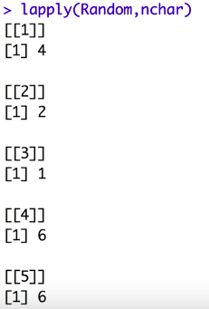

Slide 31
sapply()
sapply(object, function, ...)
OUTPUT IS SIMPLIFIED (vector, matrix, list)

Slide 32
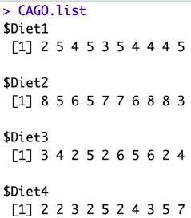

Slide 33


Slide 34
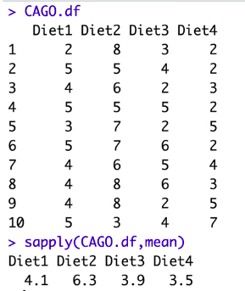
Notes:
only columns

Slide 35
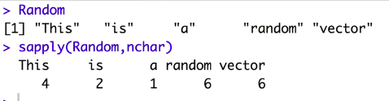

Slide 36

Part 3: dplyr package
Notes:
a grammar of data manipulation. Very fast, save time. Access data that are too big to feed r.
With dplyr, R is simply faster, bigger and better.

Slide 37
What is dplyr
Tools for data exploration and transformation
Intuitive to write and easy to read
Super-fast on data frames

Slide 38
install.packages("hflights")
hflights: Dataset on commercial domestic flights that departed Houston (IAH and HOU) in 2011.

Slide 39
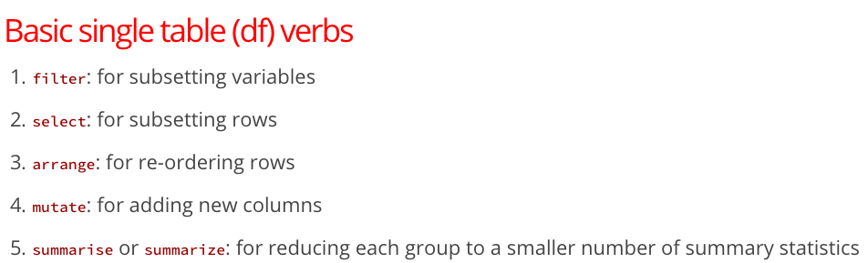

Slide 40
R markdown

Slide 41
dplyr demo in R markdown

Slide 42
Resources
Kevin Markham's tutorial
Official dplyr reference manual and vignettes on CRAN: vignettes are well-written and cover many aspects of dplyr
July 2014 webinar about dplyr (and ggvis) by Hadley Wickham and related slides/code: mostly conceptual, with a bit of code
dplyr tutorial by Hadley Wickham at the useR! 2014 conference: excellent, in-depth tutorial with lots of example code (Dropbox link includes slides, code files, and data files)
dplyr GitHub repo and list of releases

